Slide 1
Data Acquisition & Data Wrangling
By Shubham Saxena
Affiliation: DigiCrome

Slide 2
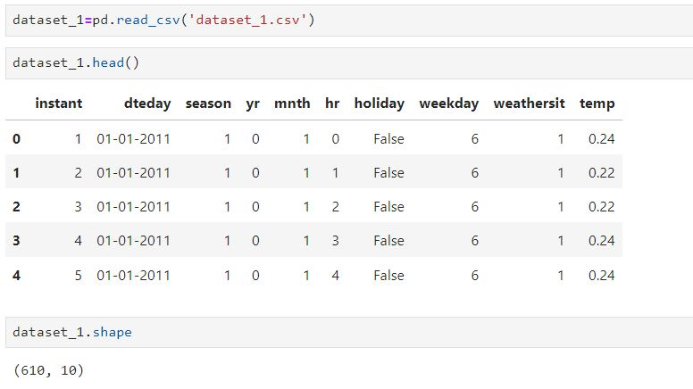
Project Overview :-
Data Acquisition & Data Wrangling for the given data of Bike rides so that further insights can be drawn for this data.
Here I have done data wrangling, central tendency of the data, filling missing values,, detection of Outliers and it’s removal, along with skewness and correlation.

Slide 3
Project Highlights :- Important libraries which are used :-
import pandas as pd
import numpy as np
from scipy import stats
import matplotlib.pyplot as plt
import seaborn as sns
Pandas
Numpy.
Iscipy
Matplotlib
seaborn

Slide 4
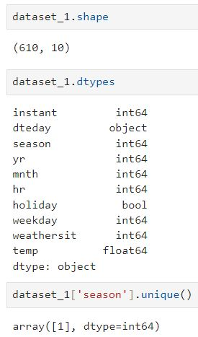
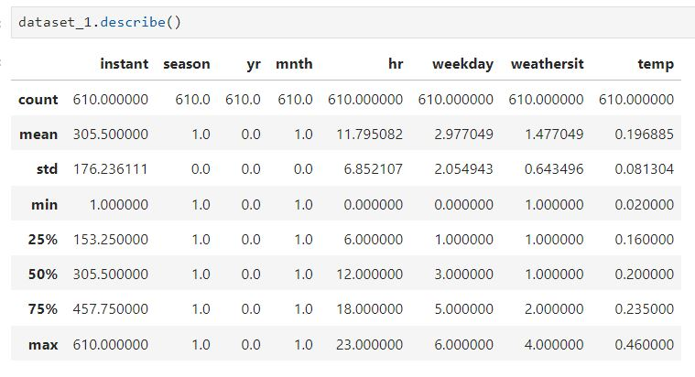
Problem Statement:- here we are doing some functions to understand dataset_1:-

Slide 5
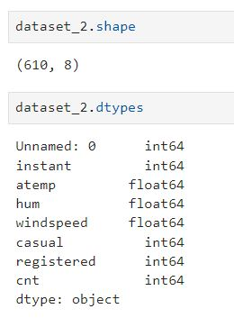
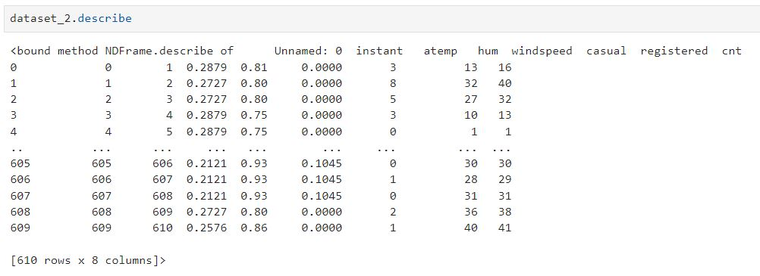
Problem Statement:- here we are doing some functions to understand dataset_2:-

Slide 6
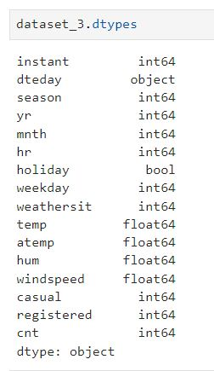
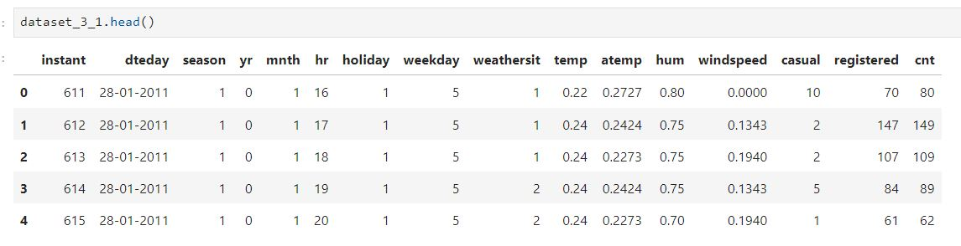
Problem Statement:- here we are doing some functions to understand dataset_3:-

Slide 7


Methodology:- Used related modules :-

Slide 8
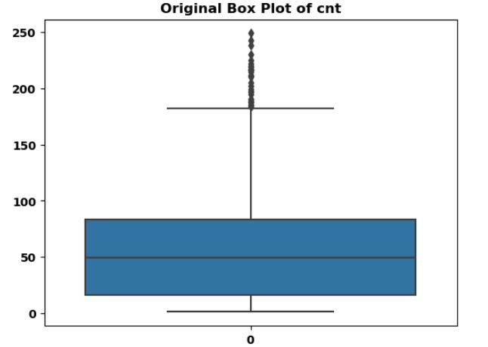
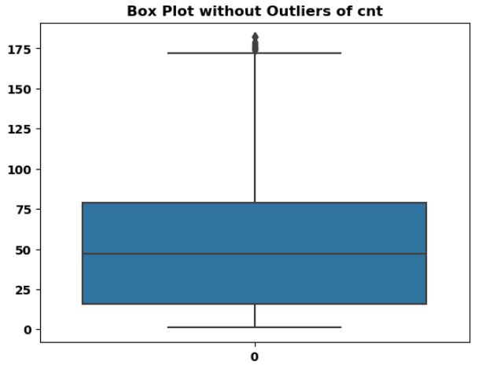
Methodology:- Used related modules to identify Outliers in final data and removed it.

Slide 9
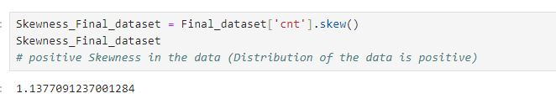
Skewness in the Final Data:-

Slide 10
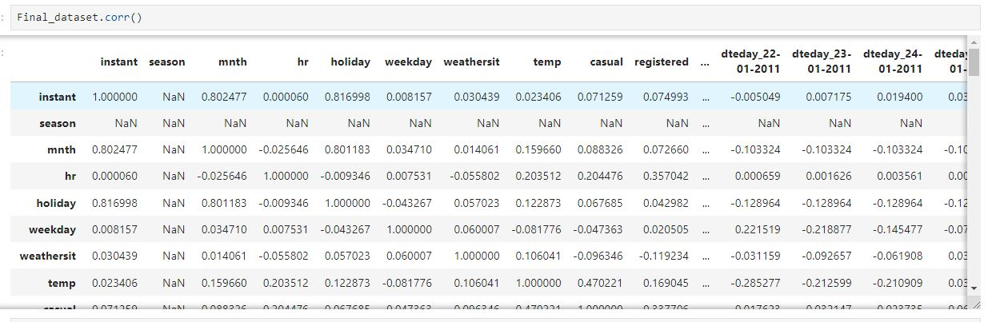
Glimpse of Final data :- Correlation of Final data with each others.

Slide 11


